Slide 1

Social Distance Monitoring
By…
Likhil (LKR46)
Madhu (MB4236)
Vuthej (VV334)

Slide 2
Overview
Research Problem and Objectives
Tools and Packages
Features Included
Flowchart and Design
Methodologies Employed
Histogram of Oriented Gradients
Deep Convolution Neural Network
Test Cases and Results
Challenges Faced
Future Scope

Slide 3

Objective
Problem How easy it is for a person to monitor public places for social distancing practice?
To design an algorithm to monitor social distancing in public places from a recorded and live feed.
Helps authorities in monitoring multiple places efficiently.

Slide 4
Tools and Packages
Language – Python
Packages –
OpenCV
TensorFlow
Numpy
Imutils
Object_detection

Slide 5
Features Included
Algorithm designed can take recorded video as input.
Algorithm designed can take live feed as input.
Dynamic display of number of violations per frame in the Output.
Dynamic display of overall percentage of violations in the video.
User have option to select any algorithm from below
HOG – Histogram of Oriented Gradients
DNN – Deep Convolution Neural Network

Slide 6
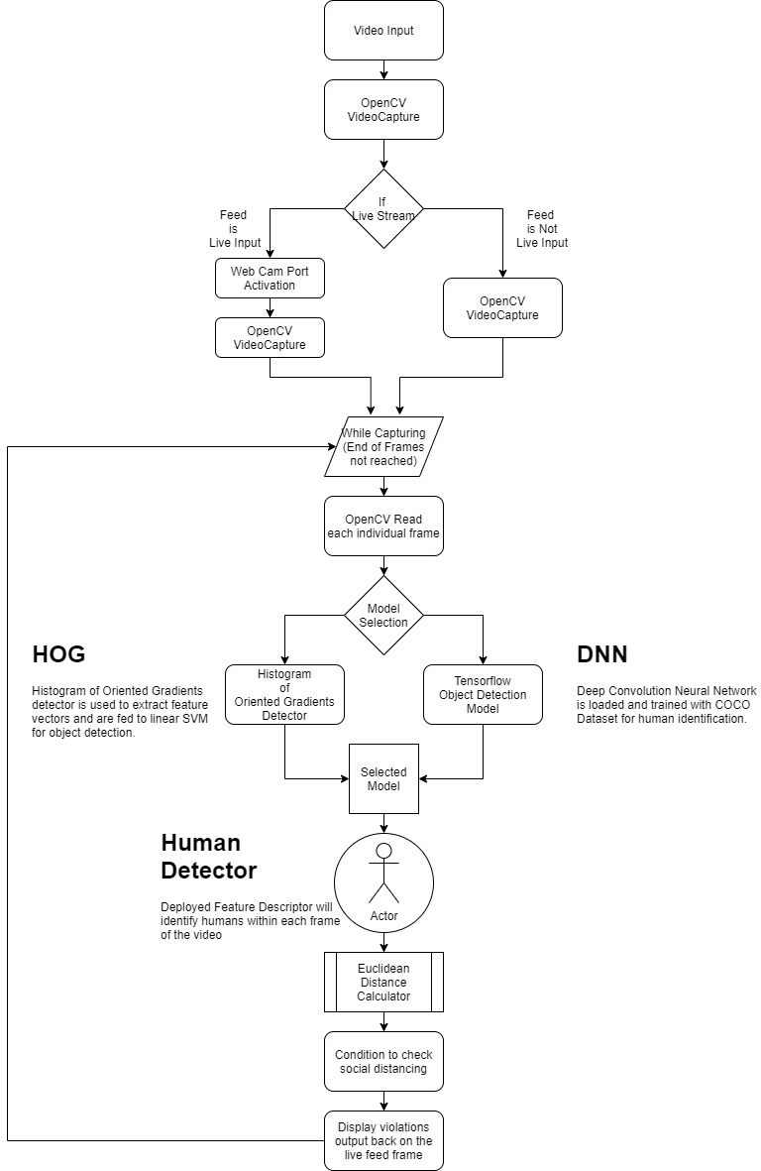
Flowchart and Design

Slide 7
Methodologies
Two methodologies included in this project to detect the social distance violation
HOG – Histogram of Oriented Gradients
DNN – Deep Convolution Neural Network

Slide 8

HOG
The histogram of oriented gradients (HOG) is a feature descriptor used in computer vision and image processing for the purpose of object detection. The technique counts occurrences of gradient orientation in localized portions of an image.
Image is transformed into 64x128 ratio for ease of calculation.
Each pixel in image is split into 8x8 cells.
Histogram is then generated for each 8x8 cell(magnitude & direction are used).
Changes in the gradients over X & Y directions are considered.

Slide 9
DNN
In deep learning, a convolution neural network is a class of deep neural networks, mostly applied to analyzing the image.
SSD Mobilenet Model from COCO
Model takes in input as tensor created from the image.
Output from the model provides
Detection_scores, Detection_class, Num_detections, Detection_boxes
Normalized output to be scaled to the frame size (multiply by frame height and width)
This is then passed on to OpenCV for plotting the rectangles.

Slide 10
Test case
HOG
Test with Live Feed
Test with recorded video
DNN
Test with Live Feed
Test with recorded video
Analyzed the output video for accuracy. (Human intervention required)

Slide 11
Results
Highlight objects violating social distancing with Red rectangular box and centroid.
Highlight objects following social distancing with Green rectangular box and centroid.
Projection of number of social distance violations in a frame.
Project percentage of social distance violations in a frame.
Autosave processed video for given recorded video as input.
Autosave processed video for given live feed as input.

Slide 12
Challenges encountered
Identification of empty spaces in a frame as object due to high intensity in HOG model.
Identification of multiple closer objects as a single object in DNN model.

Slide 13
Future Work
Improve object detection ability in both HOG and DNN models
Include social distance measurement calculation using bird eye view method

Slide 14
Thank You!

